Slide 1
Problems on Time domain analysis

Slide 2
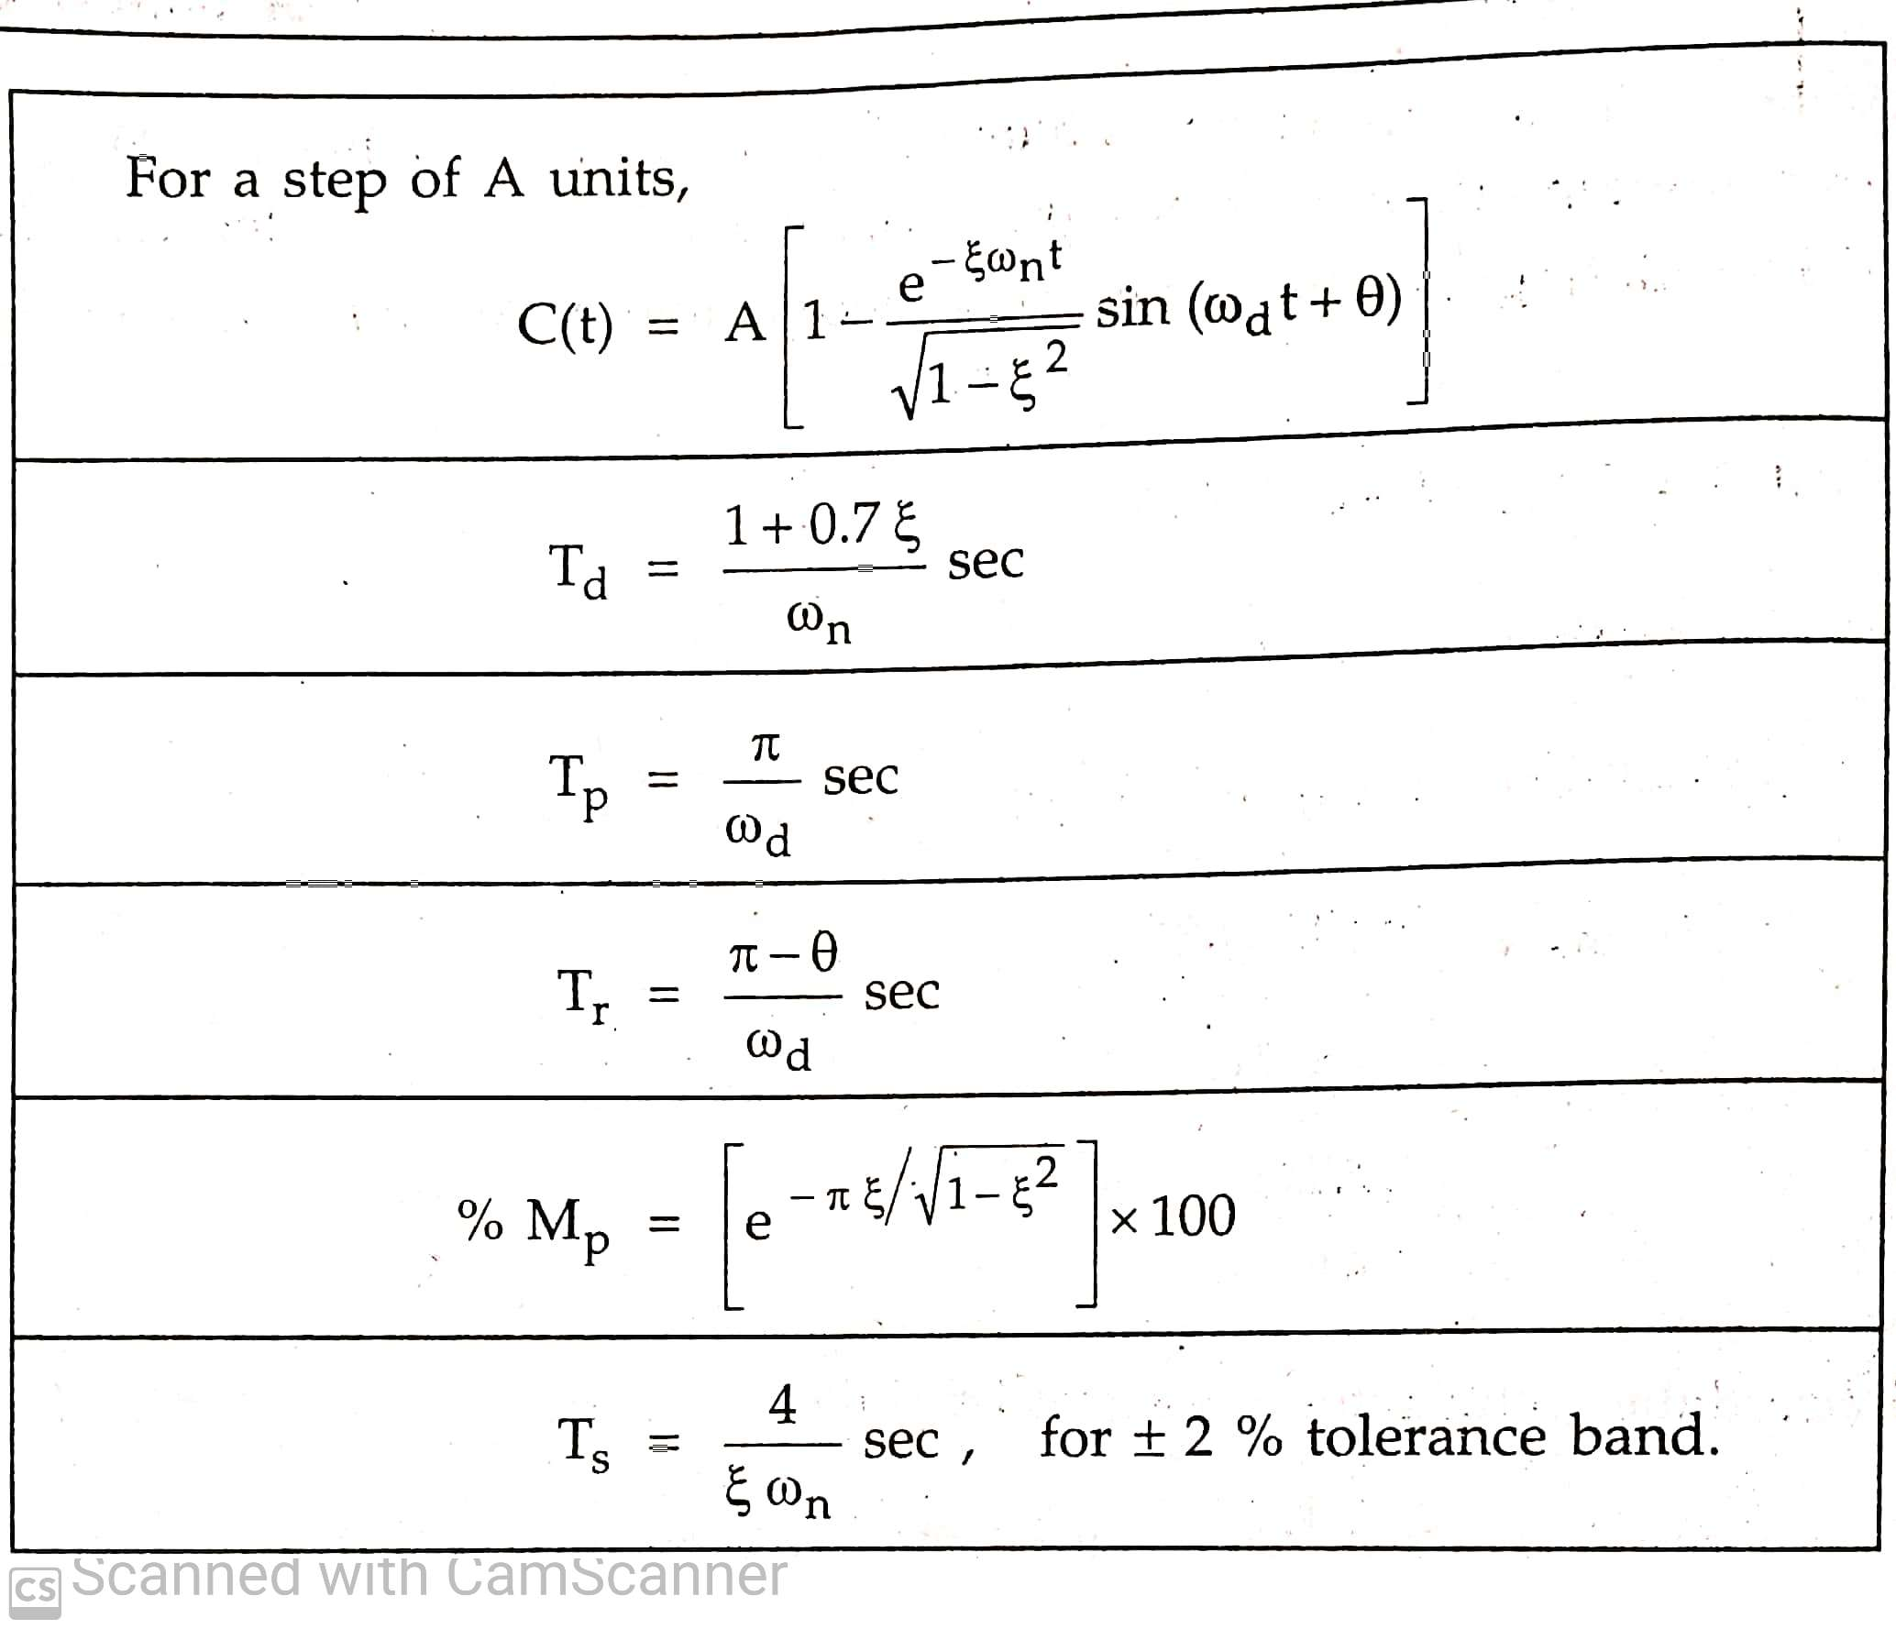
Time domain parameters

Slide 3
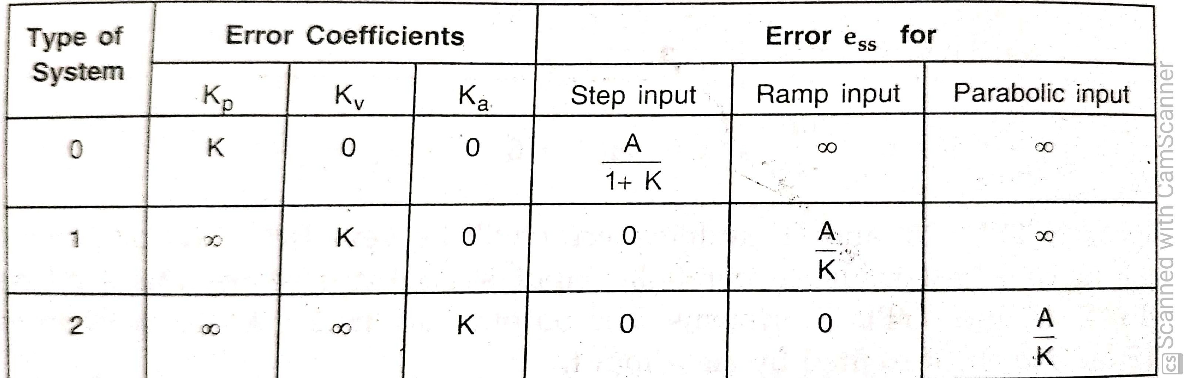
Steady state error

Slide 4
Effect of adding the poles and zeros to transfer functions
Addition of poles to the forward path of TF
Increase order of system
Increases overshoots, rise time,
Reduces stability, bandwidth,
Pushes root locus to the RHS

Slide 5
Effect of adding the poles and zeros to transfer functions
Addition of Zero to the forward path of TF
when we add Zero very far away from Im axis the over shoot is large and damping is poor
when zero is moving toward Im axis over shoot reduced and damping is improves.
But when zero moves closer to Im axis over shoots increases but damping improves.

Slide 6
Effect of adding the poles and zeros to transfer functions
Addition of poles to the closed loop TF
Increases rise time and reduces overshoots( just opposite to Addition of poles to the forward path of TF)

Slide 7
Effect of adding the poles and zeros to transfer functions
Addition of Zero to the closed loop TF
Decreases rise time and increases overshoots.

Slide 8
Dominant and insignificant Poles of transfer functions
The poles which has dominant effect of transient response is called dominant poles.
The poles near to Im in LHS give rise to transient response that will decay relatively slowly and call dominant poles
The poles far away from Im in LHS(relative to dominant poles) will decay relatively faster and call insignificant poles

Slide 9
Proper way of neglecting insignificants poles

Slide 11
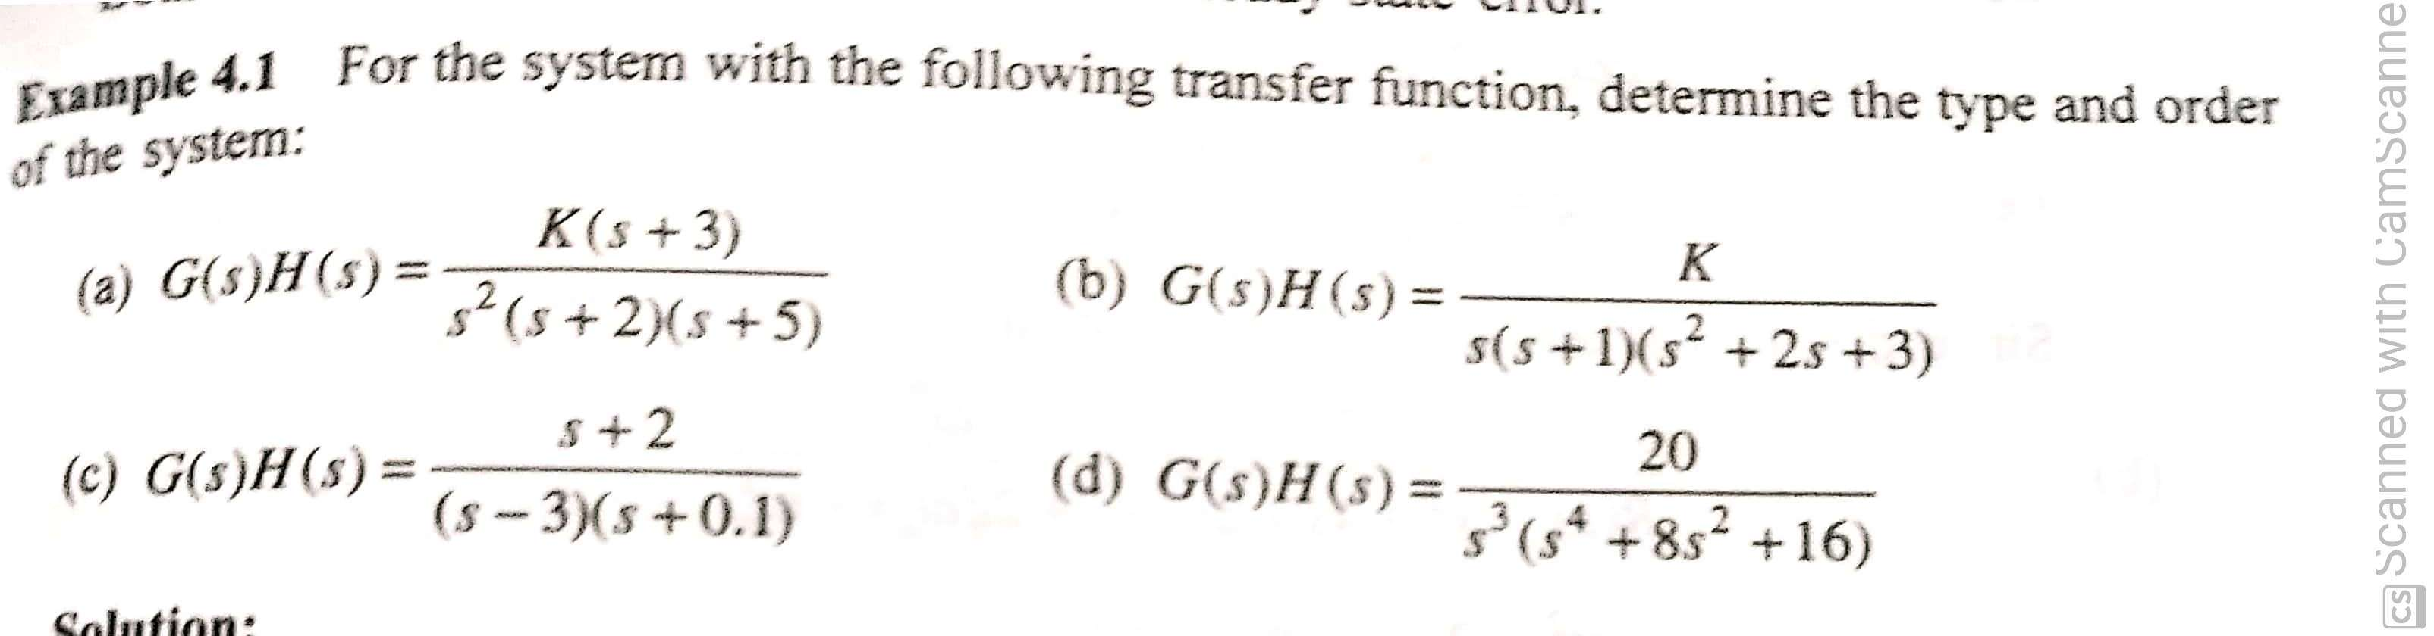

Slide 12
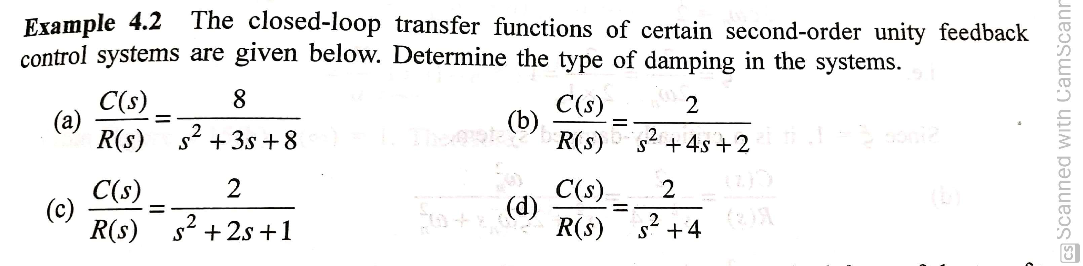

Slide 14
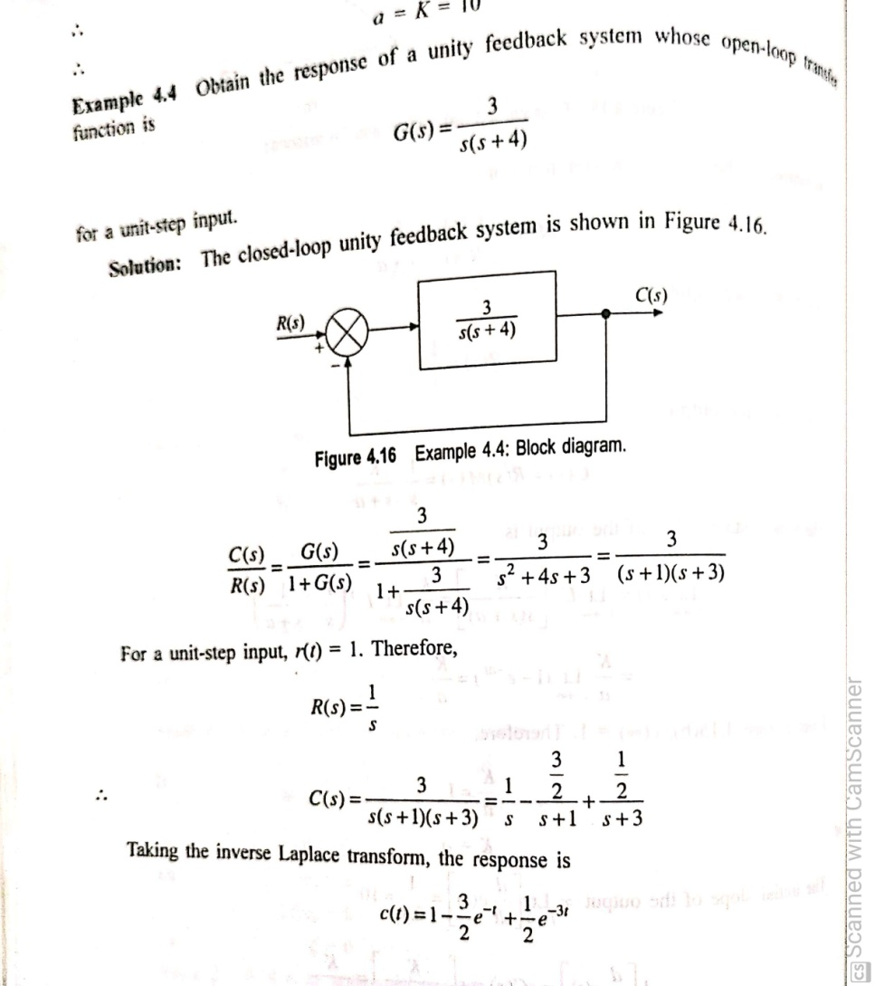

Slide 15
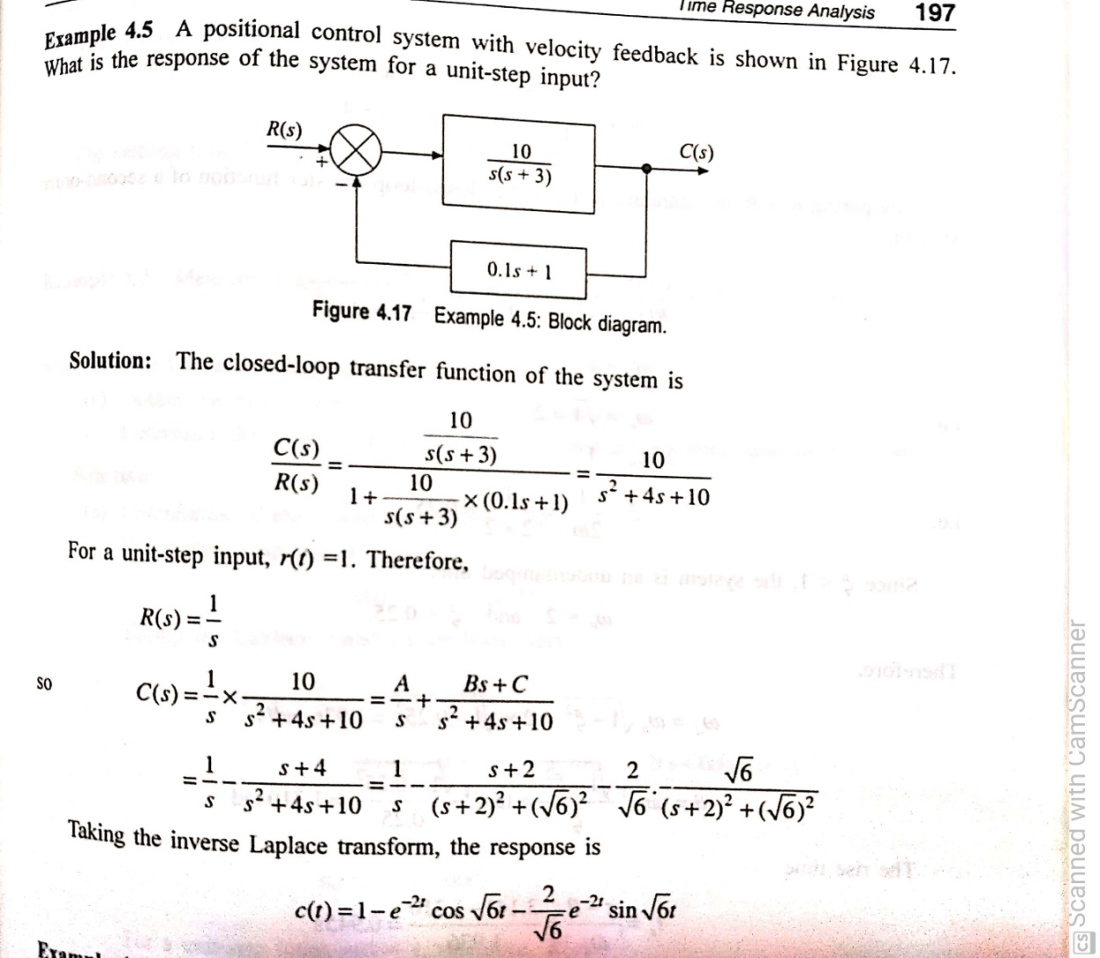

Slide 16
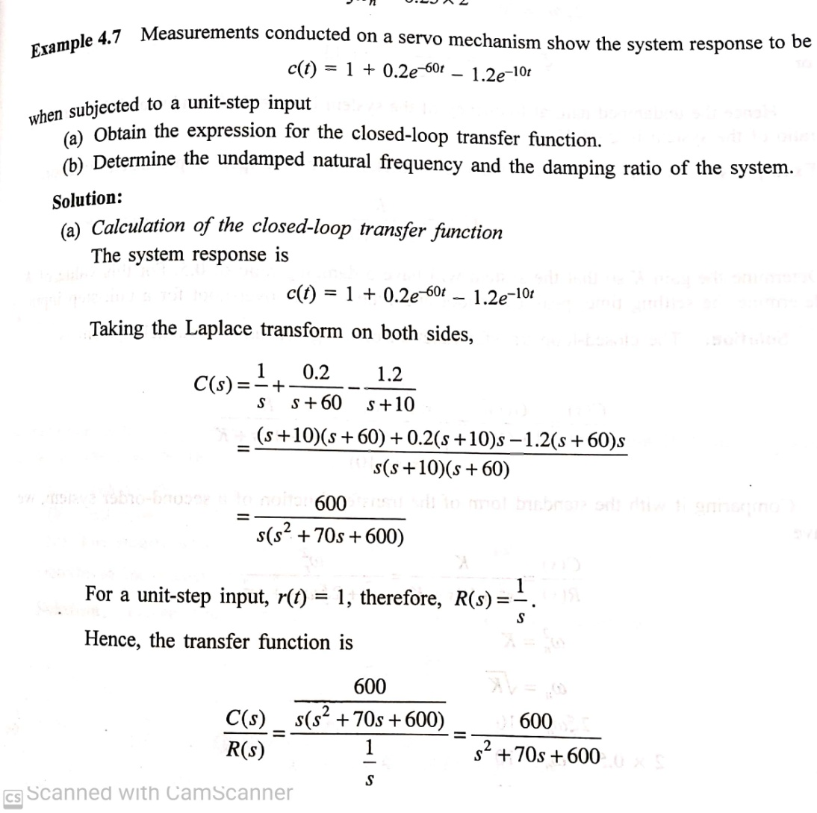

Slide 17
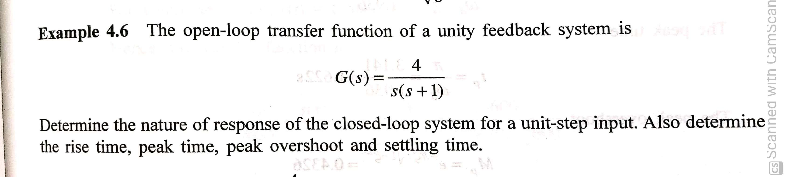

Slide 18
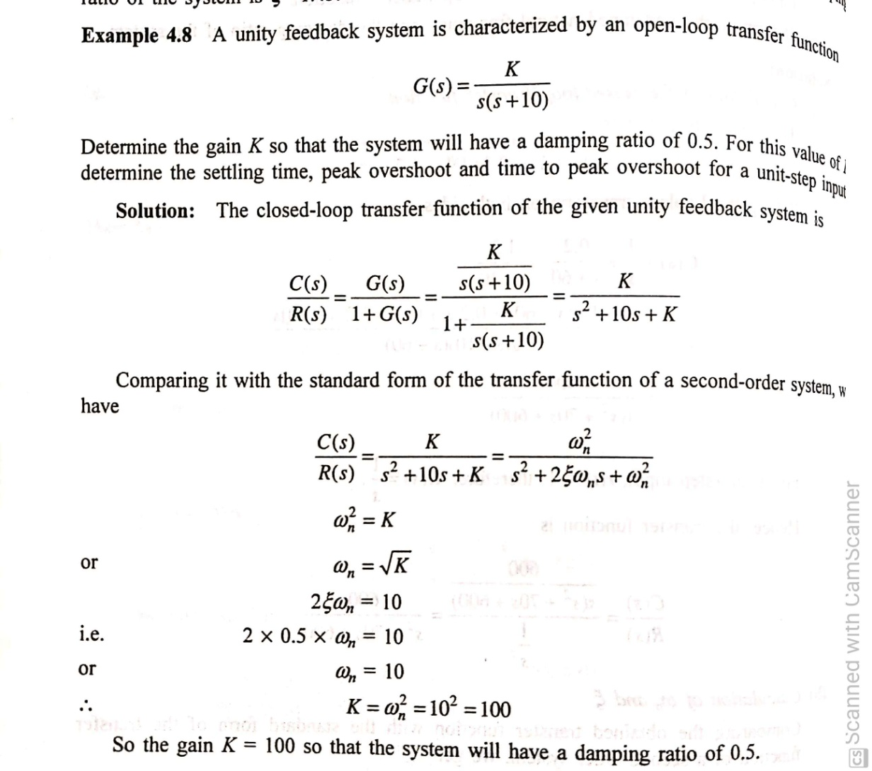

Slide 19
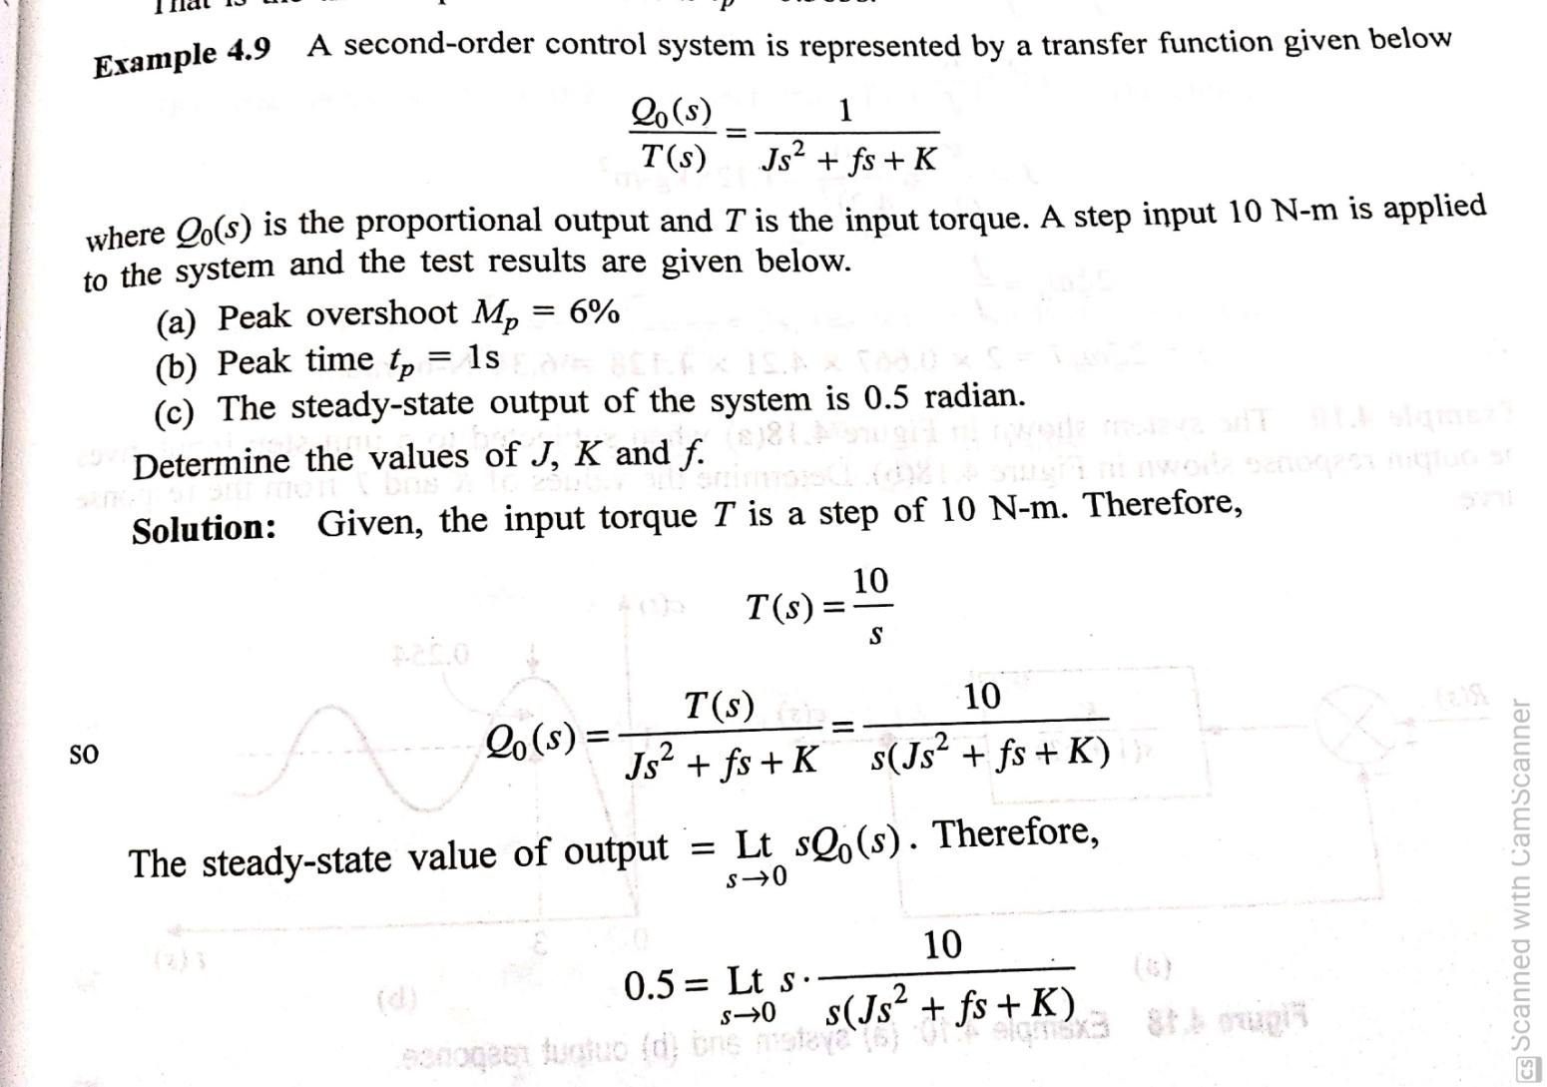

Slide 20
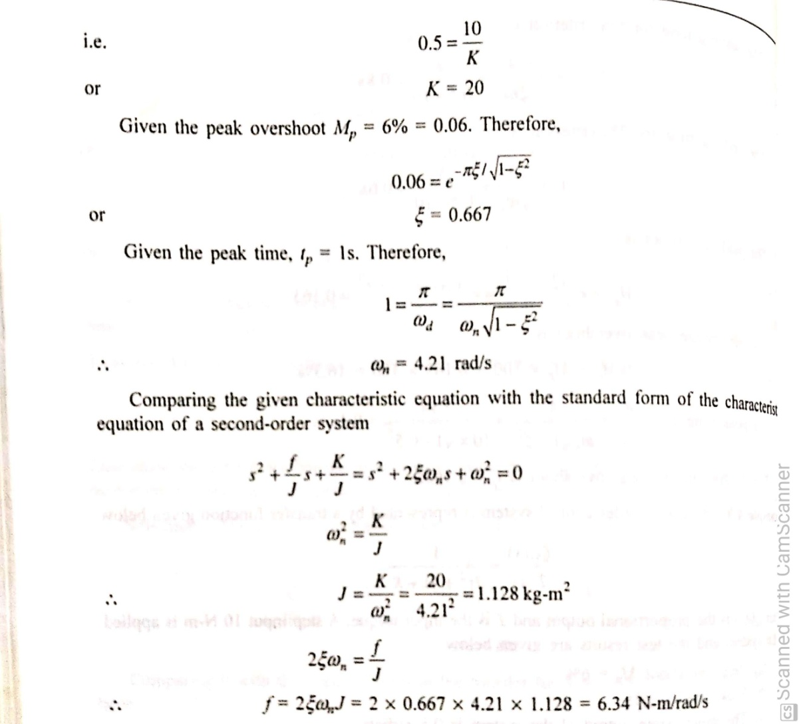

Slide 21
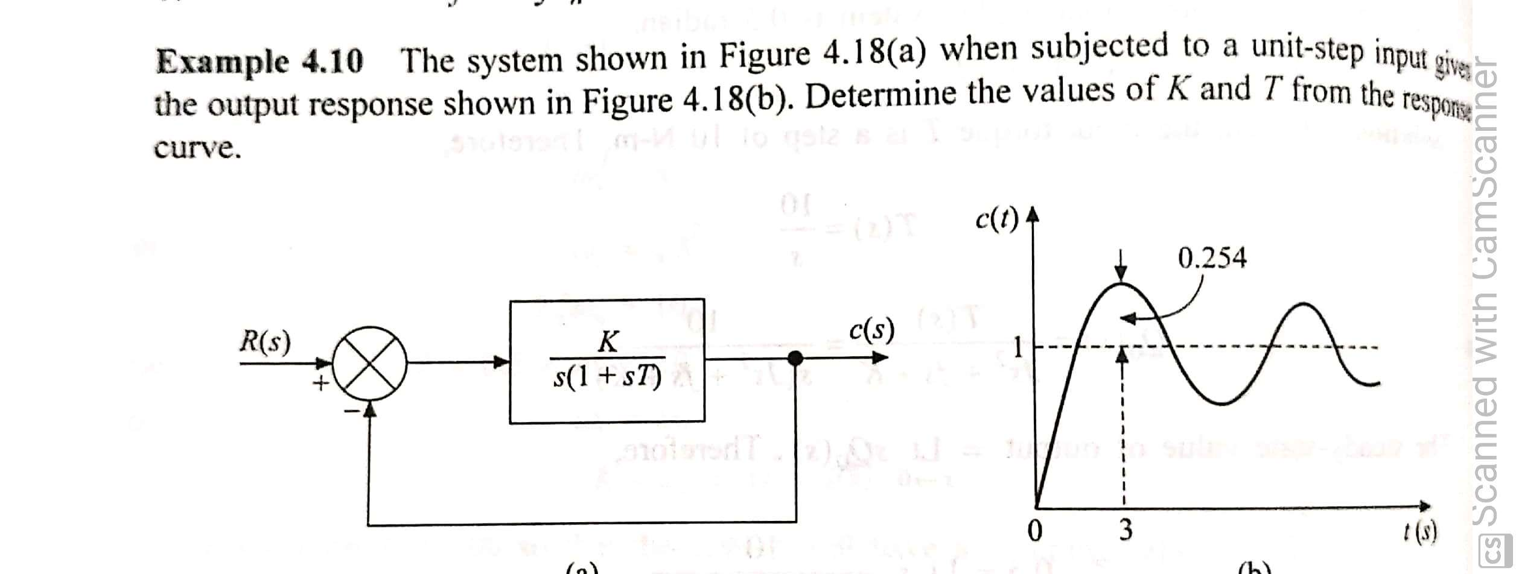

Slide 22
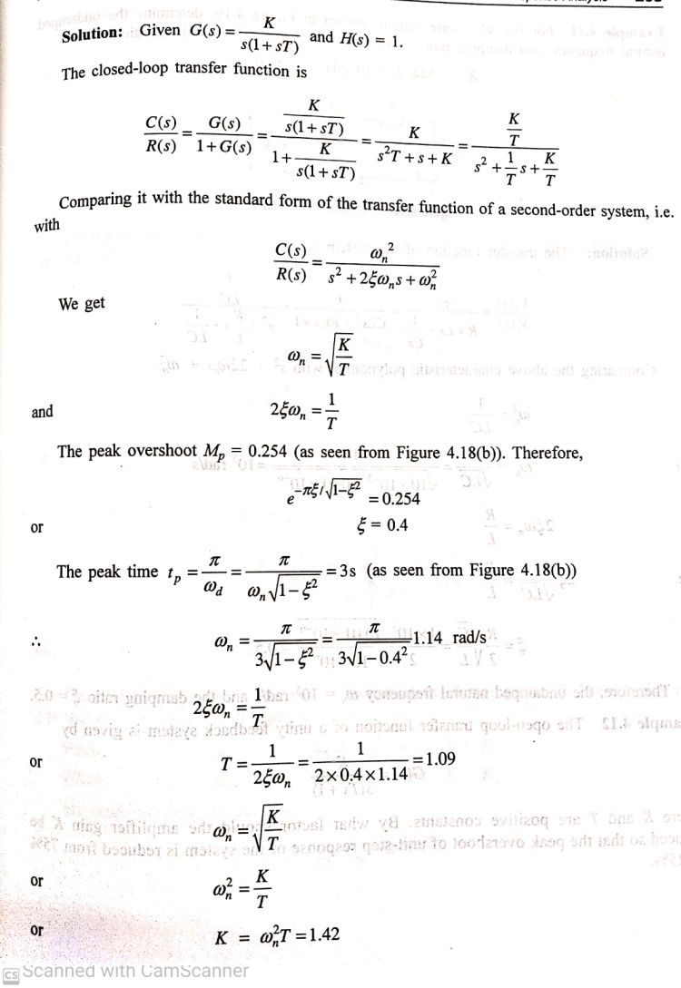

Slide 23
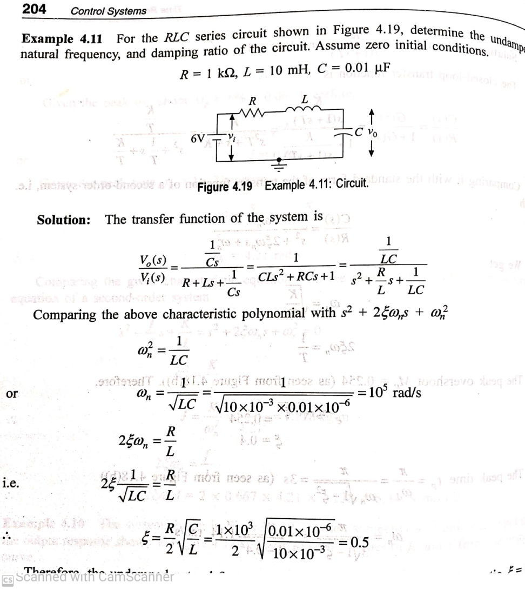

Slide 24
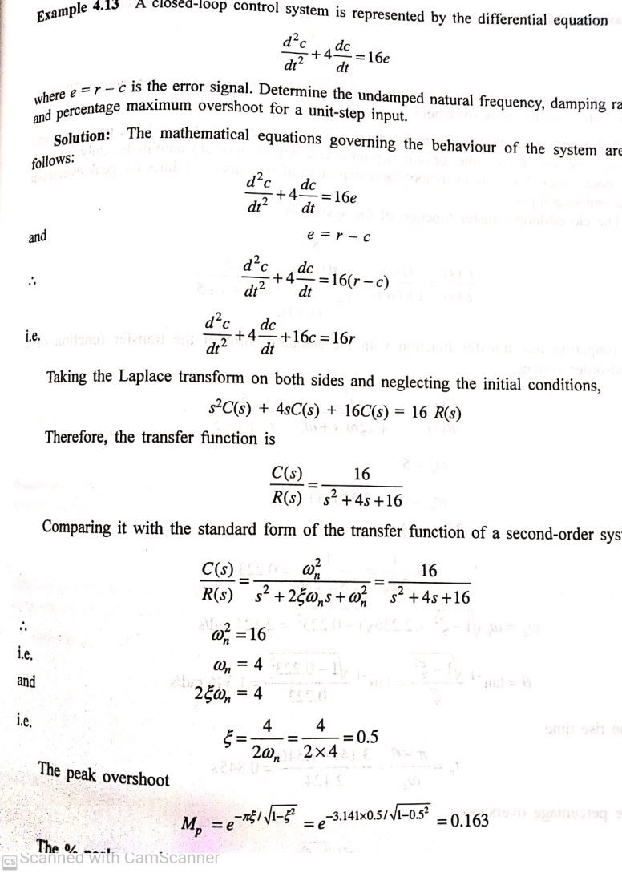

Slide 25
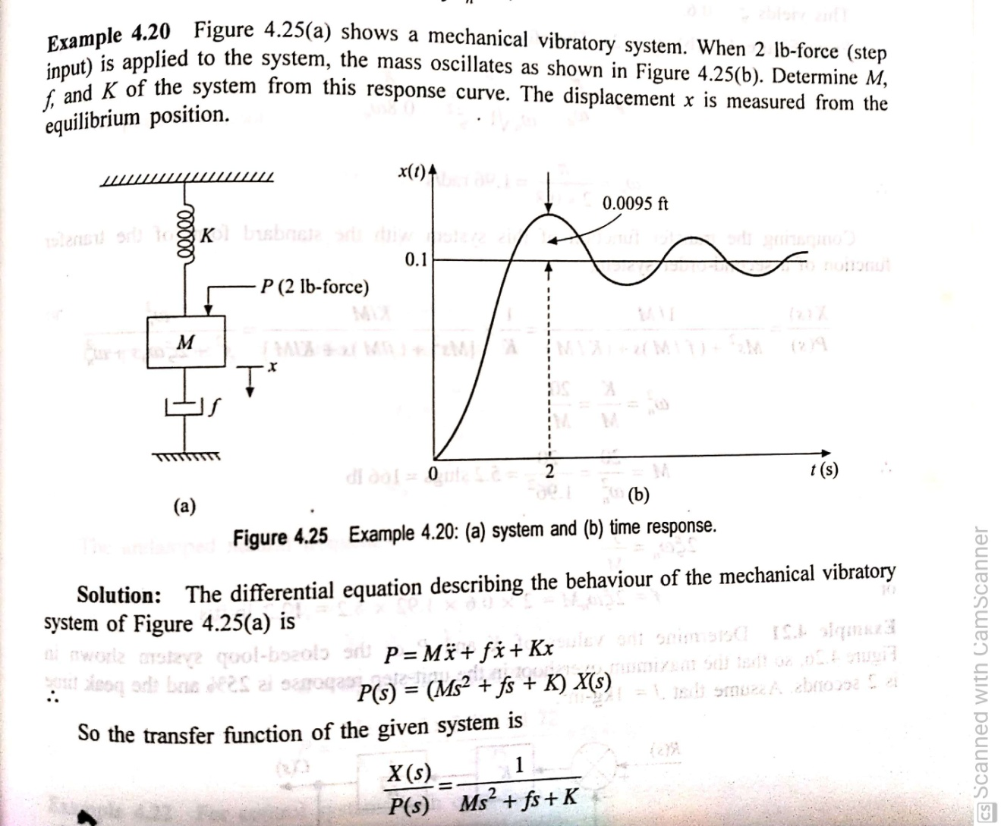

Slide 27
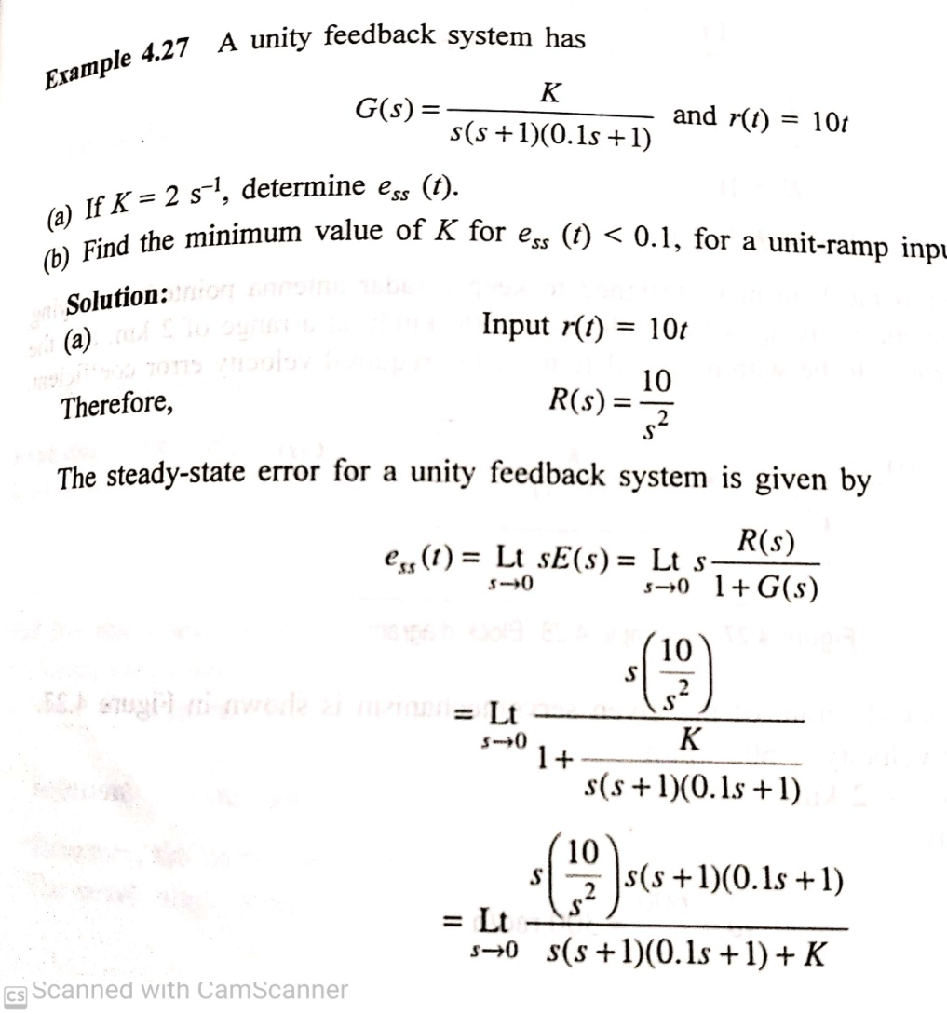

Slide 28
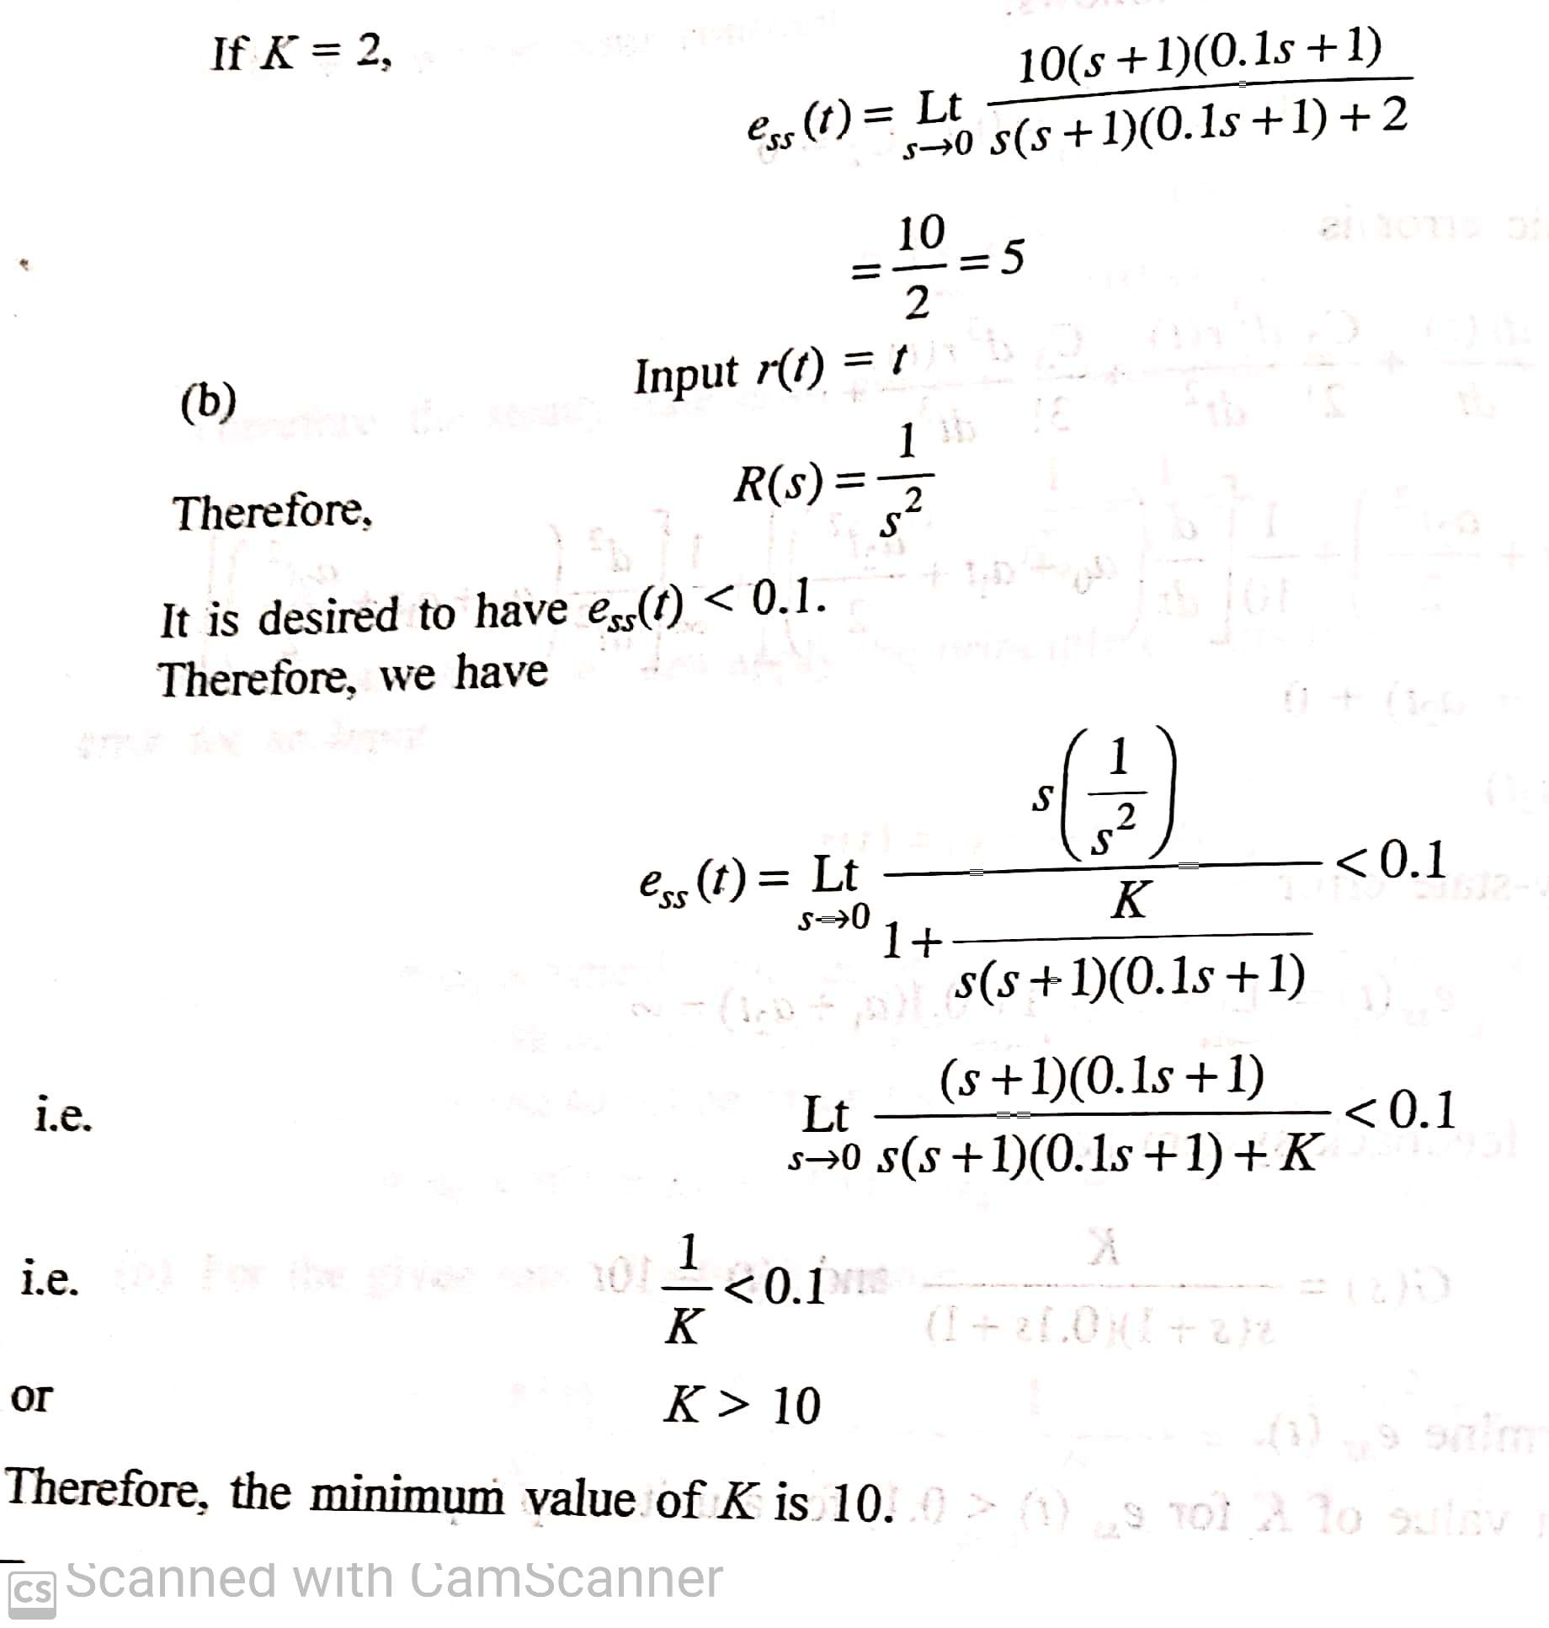

Slide 30
problems

Slide 31
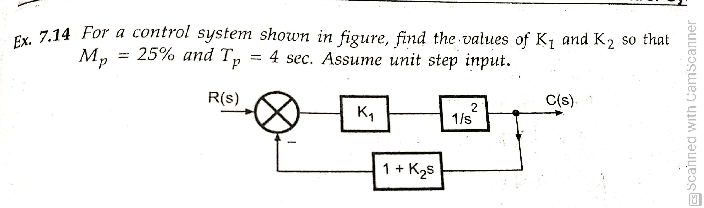
problems

Slide 32
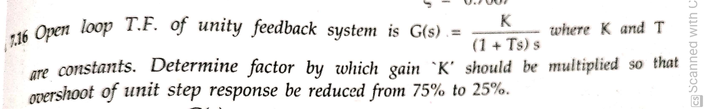

Slide 33
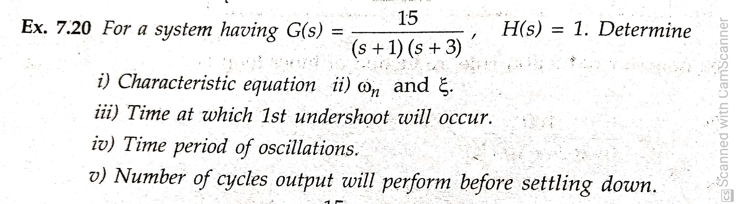

Slide 34
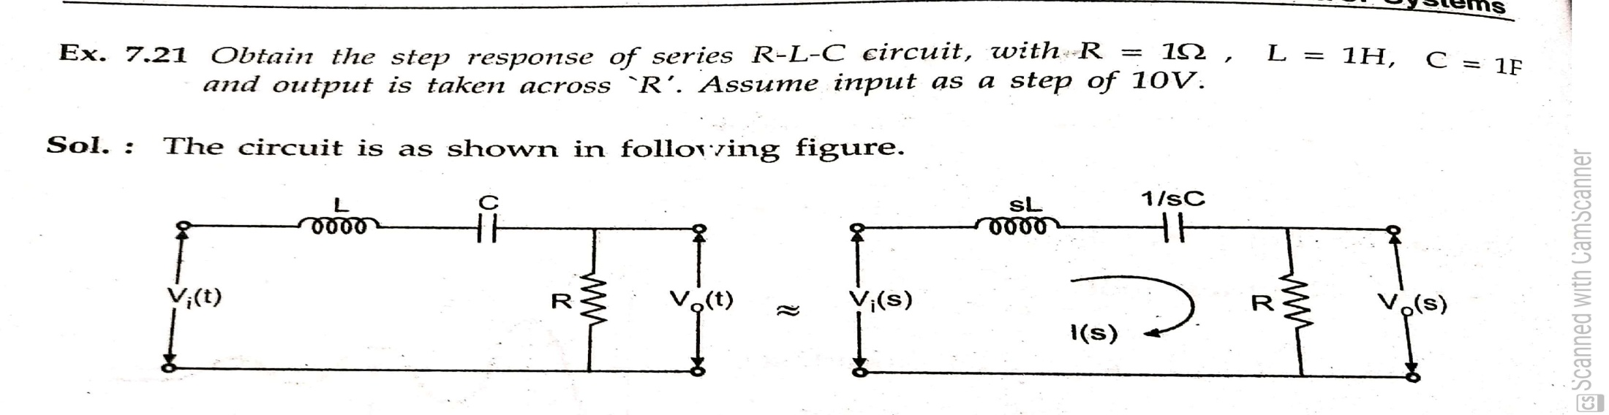

Slide 35
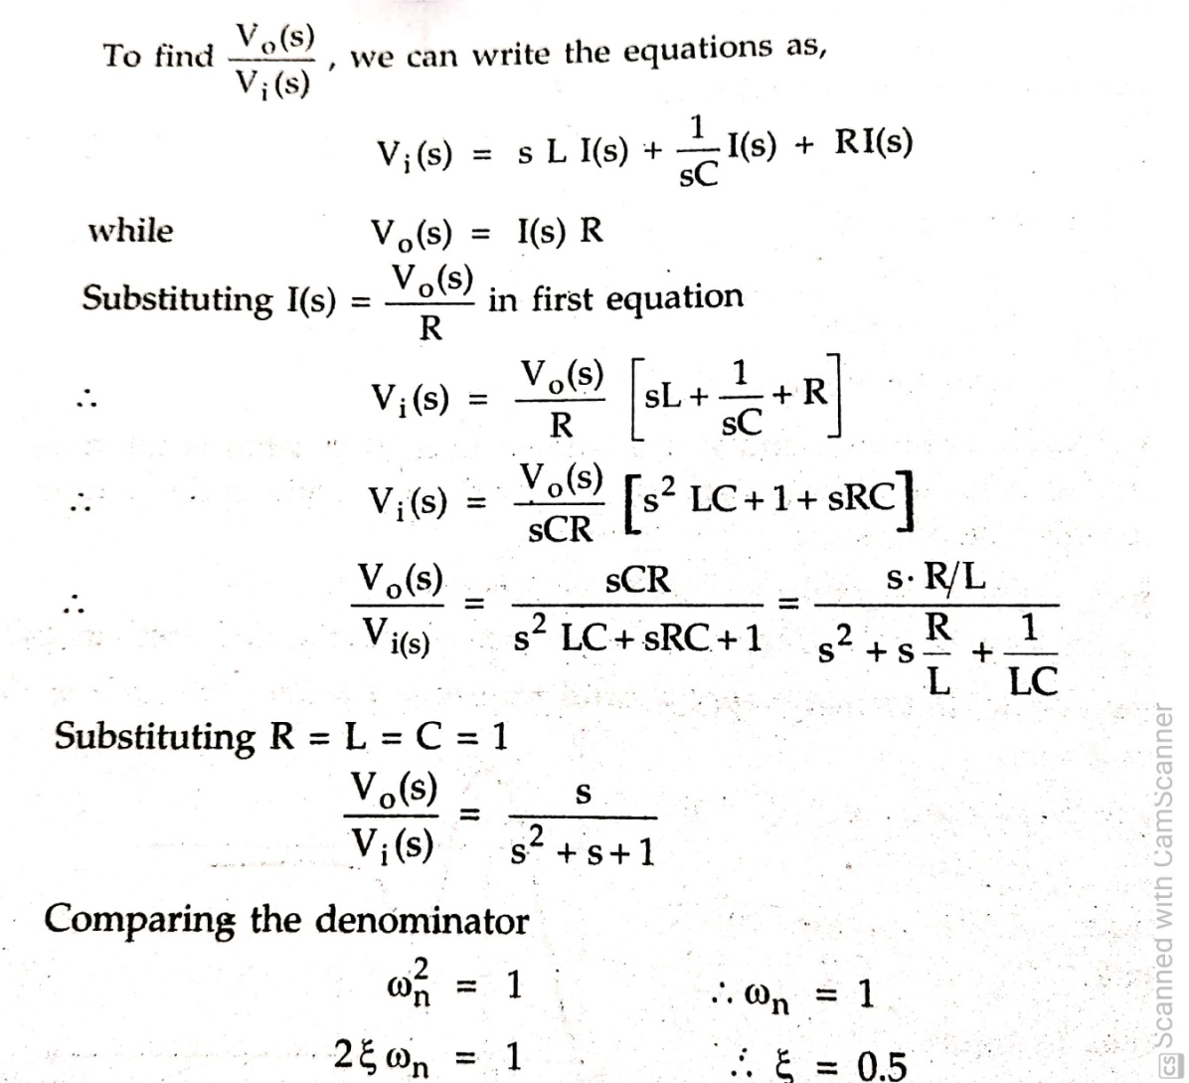

Slide 36
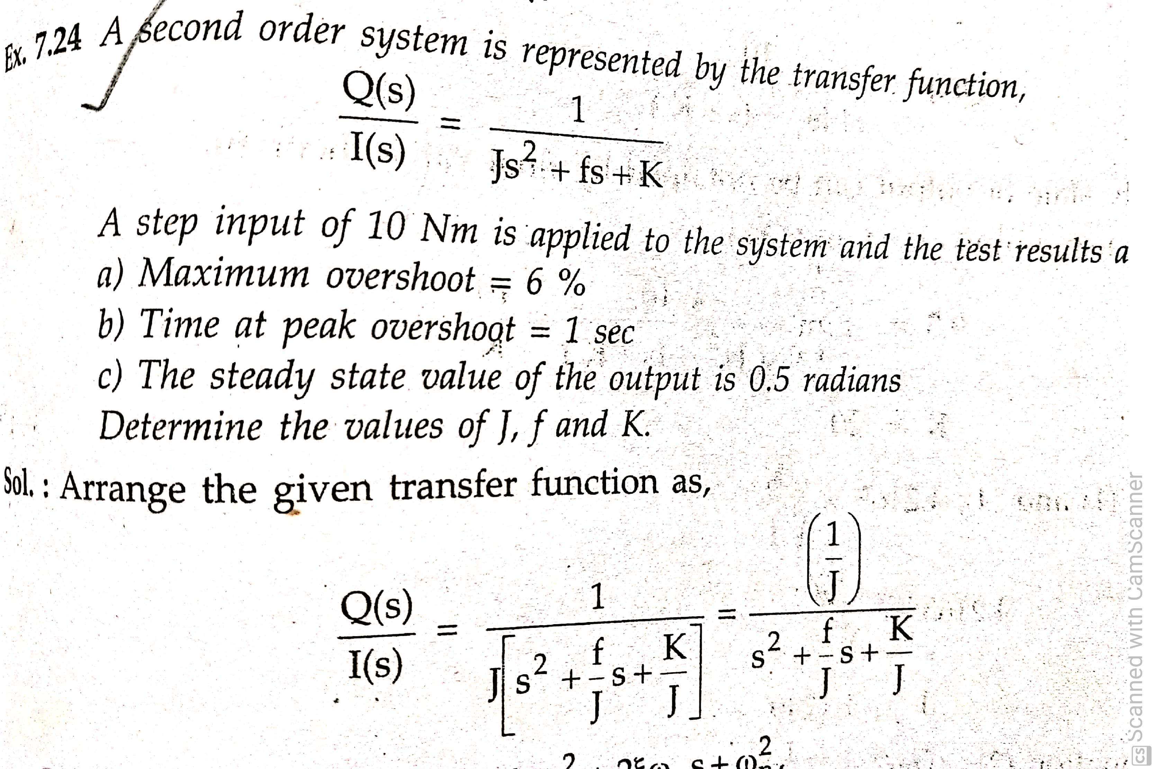
problems

Slide 37
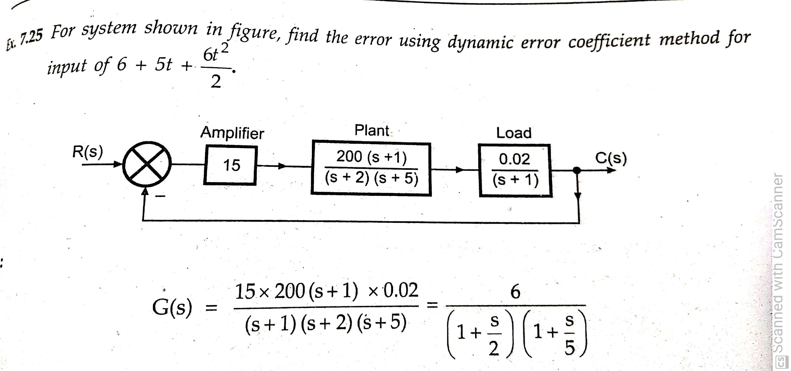

Slide 38
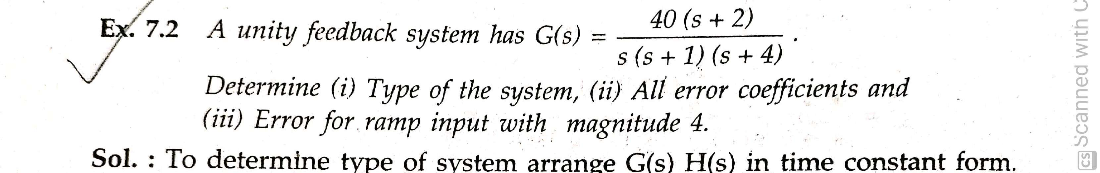

Slide 39
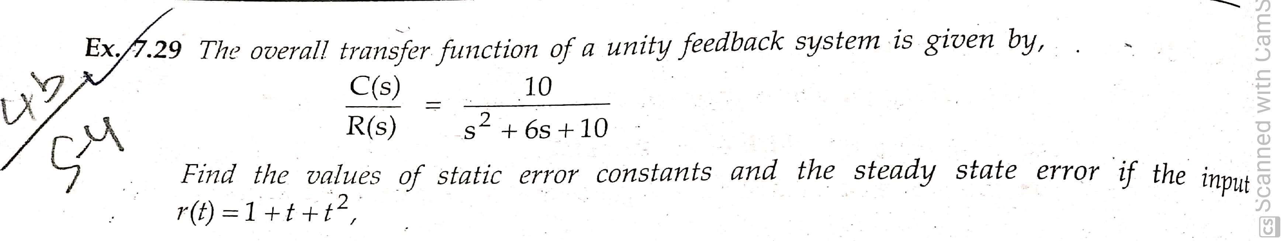

Slide 40
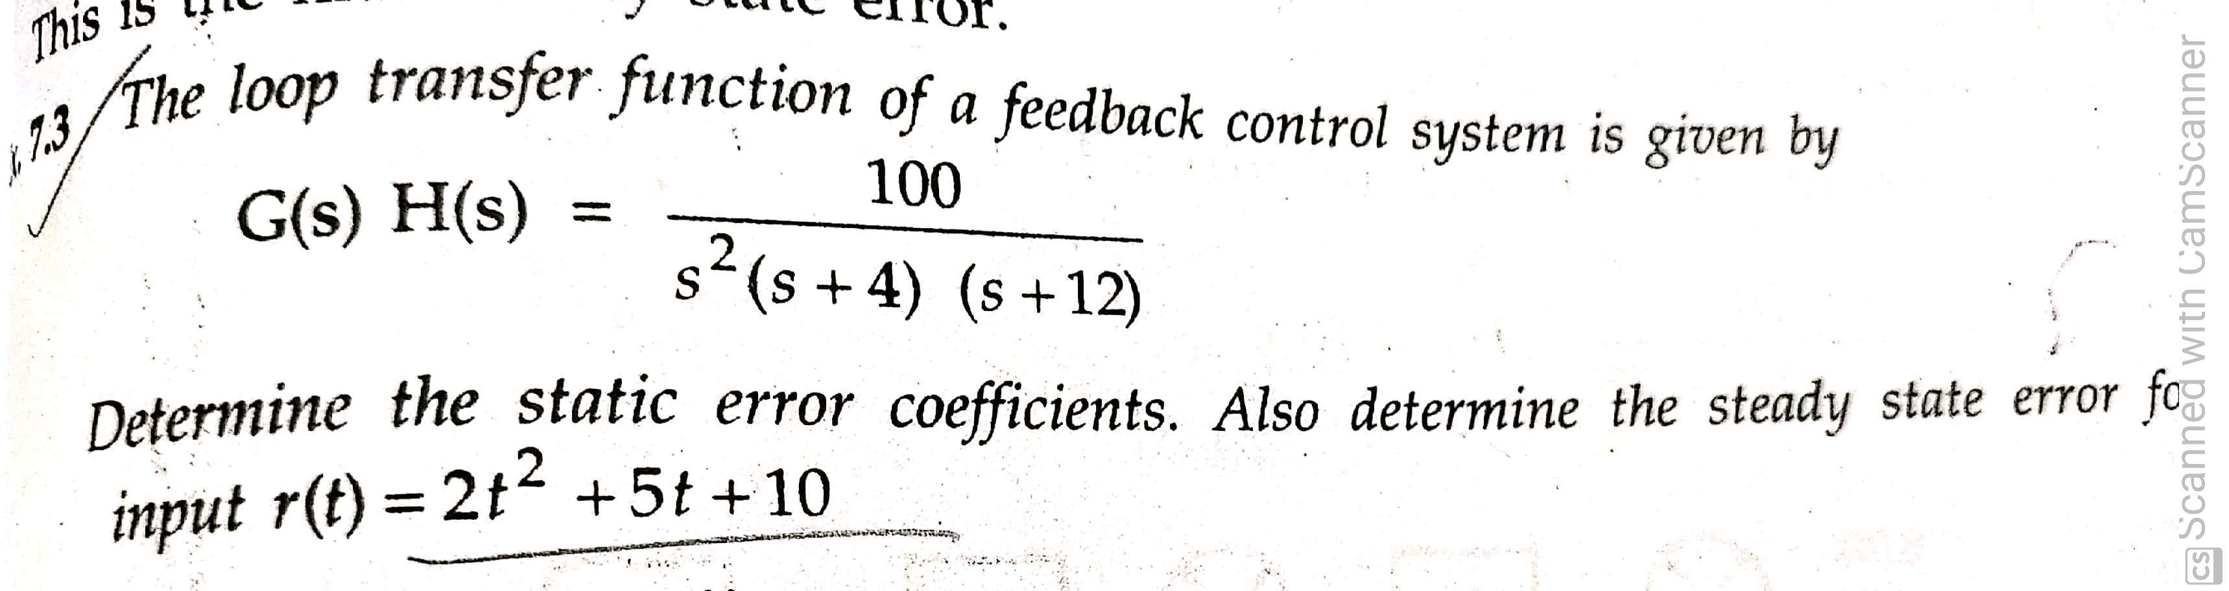

Slide 41
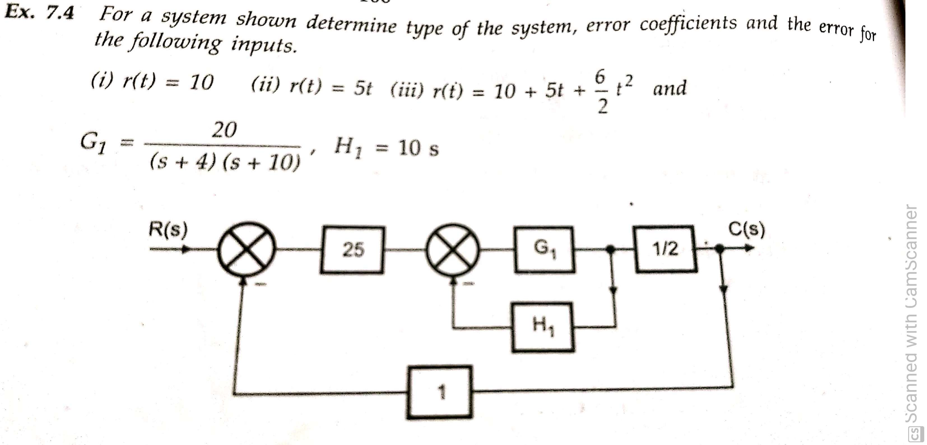

Slide 42
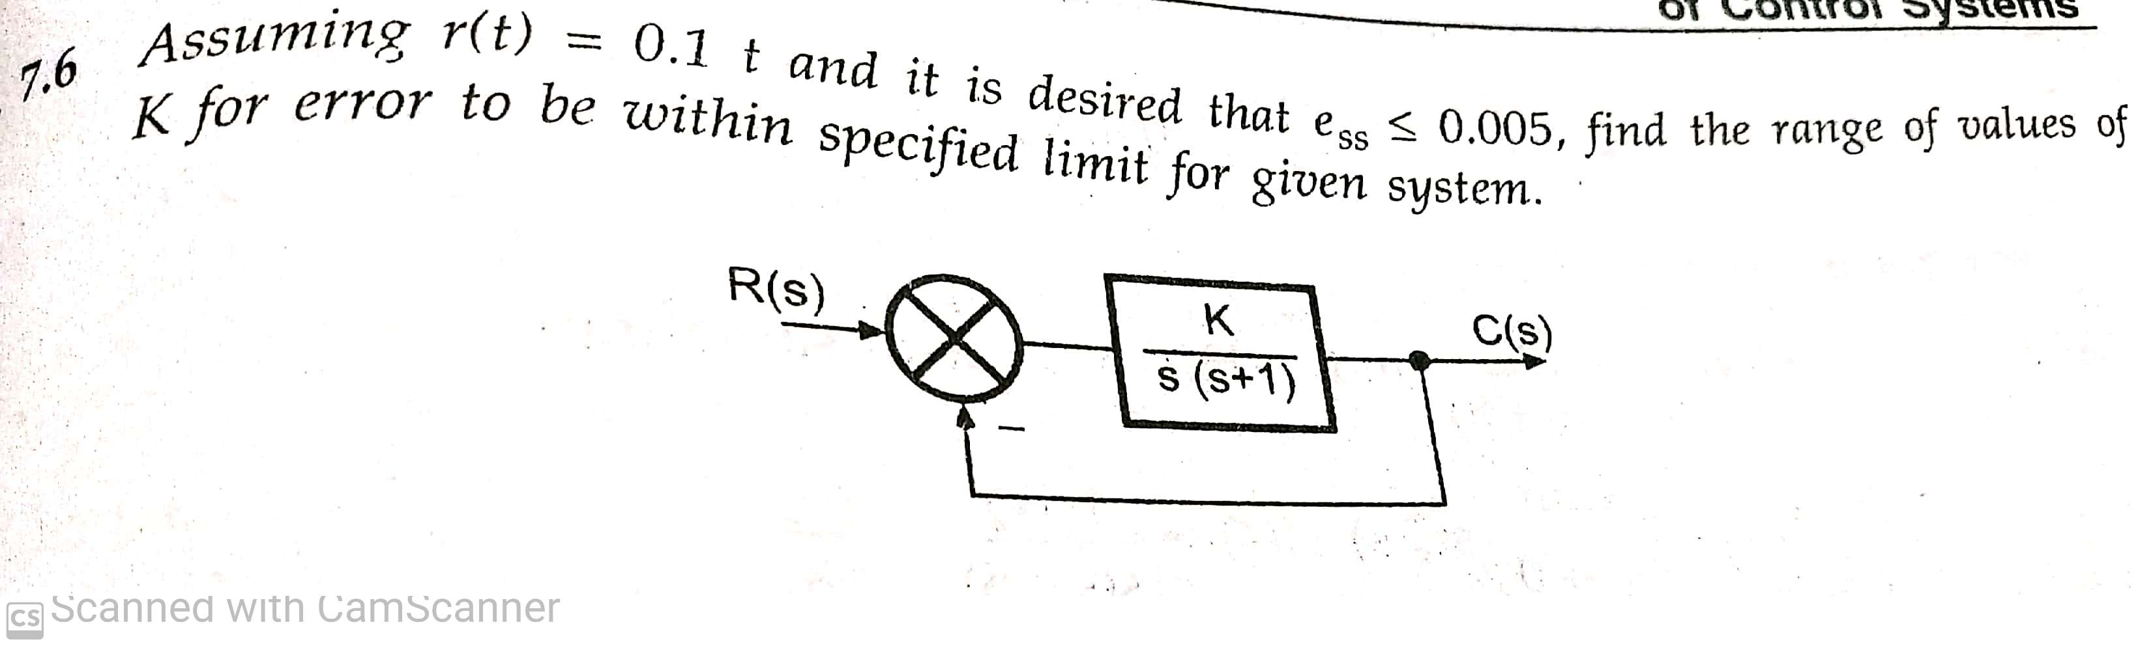

Slide 43
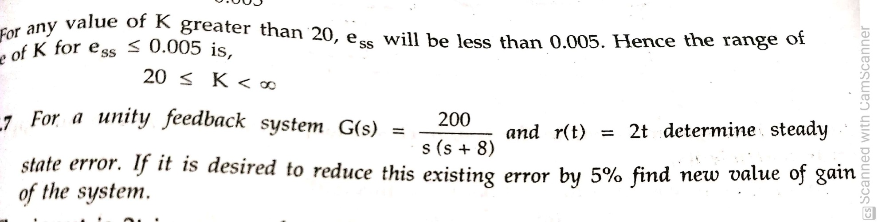

Slide 44
problems

